Slide 1

Capstone II
Housing Prices Prediction

Slide 2
Problem Statement
The objective of the capstone project is to predict Ames Housing Prices
The housing dataset consists of 79 explanatory variables and 1 dependent variable (Price).
The explanatory variables include – size, no. of years old, garage area, neighbourhood, etc.
The project entails predicting the prices using advanced regression techniques, calculating accuracy, validating them and arriving at a best possible approach. It aims at achieving most accurate prediction while reducing errors.

Slide 3
Exploratory Analysis
Data Wrangling – The dataset is taken from Kaggle (Ames Iowa Housing Prices Dataset)
Exploratory analysis consists of -
Heatmap – to draw correlation among explanatory variables and between explanatory variables and output variable
Performed bi-variate analysis between the 2 most correlated explanatory variables – Living area and Overall Quality
Performed univariate analysis for Sale Price – the distribution of sale price was not a normal distribution, so taking a logarithmic value of sale price reduced the skewness and kurtosis
Filling of missing values is done by taking 3 ways – fill with median, mode or 0 (as per the interpretation of column)
Encoding of categorical columns and scaling of numerical columns is done.

Slide 4
Modelling
The models that were created for problem statement were –
Polynomial Regression – It is a regression model to best represent relationship between dependent and independent variable. It fits the data to a polynomial equation in order to achieve a minimum cost function.
SVR (Support Vector Regression) - SVR provides the flexibility to define how much error is acceptable in our model and will find an appropriate line (or hyperplane in higher dimensions) to fit the data.
Random Forest Regression - A Random Forest is an ensemble technique capable of performing both regression and classification tasks with the use of multiple decision trees and a technique called Bootstrap Aggregation, commonly known as bagging.
A 5 fold cross validation is used to ensure the model is good with various combinations of Training and Test data.
Also, Mean absolute error, Mean squared error and Explained variance are calculated as model metrics.

Slide 5
Analysis result
Below are the results of analysis from the model building –
Model Score | Polynomial Regression | Support Vector Regression | Random Forest Regression
Accuracy | 96.07% | 95.7% | 99.2%
Mean Absolute Error | 647.87 | 11282.17 | 1368.76
Explained Variance | 0.985 | 20158.03 | 11873.31
5 fold cross validation | 0.948 | 0.944 | 0.99

Slide 6
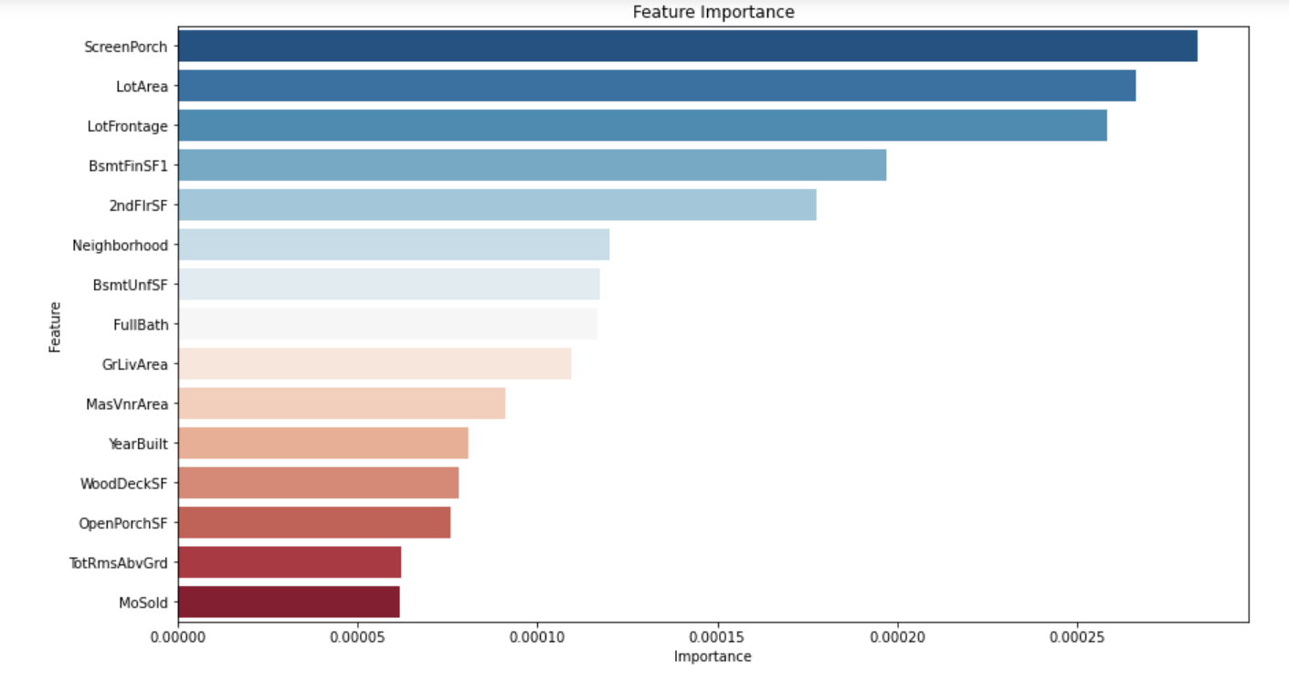
Recommendations
Based on our models built and compared , Random Forest Regression is the best model to use for predicting Housing prices. Below is a feature importance graph drawn to compare –

